Slide 1
Communicating, Perceiving and Acting
Module 7

Slide 2
Language Models
Language models: models that predict the probability distribution of language expressions.
Formal languages, such as the programming languages Java or Python, have precisely defined language models.
A language can be defined as a set of strings; “print(2 + 2)” is a legal program in the language Python, whereas “2)+(2 print” is not.
So there is a set of rules called a grammar.
Formal languages also have rules that define the meaning or semantics of a program;
for example, the rules say that the “meaning” of “2+2” is 4, and the meaning of “1/0” is that an error is signaled.

Slide 3
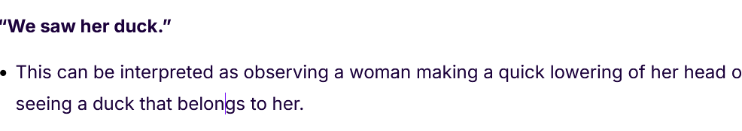

Ambiguous sentence

Slide 4
Language Models
Natural languages, such as English or Spanish, cannot be characterized as a definitive set of sentences.
Language modeling is a technique that predicts the order of words in a sentence.
Everyone agrees that “Not to be invited is sad” is a sentence of English,
but people disagree on the grammaticality of “To be not invited is sad.”

Slide 5
Language Models
Language modeling is used in artificial intelligence (AI), natural language processing (NLP), natural language understanding and natural language generation systems, particularly ones that perform text generation, machine translation and question answering.
Large language models (LLMs) also use language modeling.
These are advanced language models, such as OpenAI's GPT-3 and Google's Palm 2, that handle billions of training data parameters and generate text output.

Slide 6
Language modeling types: N-gram character models
N-gram – This is a simple approach to a language model creates a probability distribution for a sequence of n. The n can be any number and defines the size of the gram, or sequence of words. This allows the model to accurately predict the next word or variable in a sentence.
Unigram- It evaluates each word or term independently. Unigram models commonly handle language processing tasks such as information retrieval.
Bidirectional- Unlike n-gram models, which analyze text in one direction, backward, bidirectional models analyze text in both directions, backward and forward.
Exponential - it evaluates text using an equation that combines feature functions and n-grams.
Neural language models - Neural language models use deep learning techniques to overcome the limitations of n-gram models. These models use neural networks, such as recurrent neural networks (RNNs), and transformers to capture complex patterns and dependencies in text.

Slide 7
N-gram character models
A written text is composed of characters—letters, digits, punctuation, and spaces in English.
Thus, one of the simplest language models is a probability distribution over sequences of characters.
A sequence of written symbols of length n is called an n-gram , with special case “unigram” for 1-gram, “bigram” for 2-gram, and “trigram” for 3-gram.
A model of the probability distribution of n-letter sequences is thus called an n-gram model.

Slide 8

N-gram character models
An n-gram model is defined as a Markov chain of order n − 1.
In a Markov chain the probability of character ci depends only on the immediately preceding characters, not on any other characters.
So in a trigram model we have

Slide 9

N-gram character models
We can define the probability of a sequence of characters P(c1:N ) under the trigram model by first factoring with the chain rule and then using the Markov assumption:
For a trigram character model in a language with 100 characters, P(Ci|Ci−2:i−1) has a million entries, and can be accurately estimated by counting character sequences in a body of text of 10 million characters or more.

Slide 10
N-gram character models
language identification: with n-gram character models we can identify language
Given a text, determine what natural language it is written in.
This is a relatively easy task; even with short texts such as “Hello, world” or “Wie geht es dir,” it is easy to identify the first as English and the second as German.
Computer systems identify languages with greater than 99% accuracy; occasionally, closely related languages, such as Swedish and Norwegian, are confused.

Slide 11

N-gram character models
One approach to language identification is to first build a trigram character model of each candidate language, where the variable l ranges over languages.
For each l the model is built by counting trigrams in a corpus of that language.
That gives us a model of P(Text | Language), but we want to select the most probable language given the text, so we apply Bayes’ rule followed by the Markov assumption to get the most probable language

Slide 12
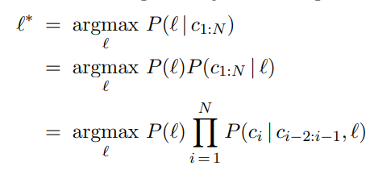
N-gram character models

Slide 13
Smoothing n-gram models
The process of adjusting the probability of low-frequency counts is called smoothing.
The simplest type of smoothing was suggested by Pierre-Simon Laplace in the 18th century: if a random Boolean variable X has been false in all n observations so far then the estimate for P(X = true) should be 1/(n+ 2).
That is, he assumes that with two more trials, one might be true and one false.
Laplace smoothing (also called add-one smoothing) is a step in the right direction, but performs relatively poorly

Slide 14

Smoothing n-gram models
A better approach is a back-off model, in which we start by estimating n-gram counts, but for any particular sequence that has a low (or zero) count, we back off to (n − 1)-grams.
Linear interpolation smoothing is a backoff model that combines trigram, bigram, and unigram models by linear interpolation.
It defines the probability estimate as

Slide 15
Information retrieval (IR)
Information retrieval is the task of finding documents that are relevant to a user’s need for information. The best-known examples of information retrieval systems are search engines on the World Wide Web.
An information retrieval system can be characterized by:
A corpus of documents. Each system must decide what it wants to treat as a document: a paragraph, a page, or a multipage text.

Slide 16
Information retrieval
Queries posed in a query language. A query specifies what the user wants to know. The query language can be just a list of words, such as [AI book]; or it can specify a phrase of words that must be adjacent, as in [“AI book”];
A result set. This is the subset of documents that the IR system judges to be relevant to the query.
A presentation of the result set. This can be as simple as a ranked list of document titles or as complex as a rotating color map of the result set projected onto a three dimensional space, rendered as a two-dimensional display.

Slide 17
IR scoring functions
A scoring function takes a document and a query and returns a numeric score; the most relevant documents have the highest scores.
In the BM25 function, the score is a linear weighted combination of scores for each of the words that make up the query.
Three factors affect the weight of a query term: First, the frequency with which a query term appears in a document (also known as TF for term frequency). For the query [farming in Kansas], documents that mention “farming” frequently will have higher scores

Slide 18
IR scoring functions
Second, the inverse document frequency of the term, or IDF. The word “in” appears in almost every document, so it has a high document frequency, and thus a low inverse document frequency, and thus it is not as important to the query as “farming” or “Kansas.”
Third, the length of the document. A million-word document will probably mention all the query words, but may not actually be about the query. A short document that mentions all the words is a much better candidate.

Slide 19
IR scoring functions
The BM25 function takes all three of these into account.
We assume we have created an index of the N documents in the corpus so that we can look up TF(qi, dj ), the count of the number of times word qi appears in document dj .
We also assume a table of document frequency counts, DF(qi), that gives the number of documents that contain the word qi.

Slide 20
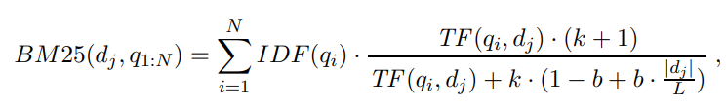


IR scoring functions
Then, given a document dj and a query consisting of the words q1:N , we have
where |dj | is the length of document dj in words, and L is the average document length in the corpus: .
We have two parameters, k and b, that can be tuned by cross-validation; typical values are k = 2.0 and b = 0.75. IDF(qi) is the inverse document frequency of word qi, given by

Slide 21
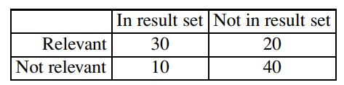
IR system evaluation
Traditionally, there have been two measures used in the scoring: recall and precision.
Imagine that an IR system has returned a result set for a single query, for which we know which documents are and are not relevant, out of a corpus of 100 documents. The document counts in each category are given in the following table:

Slide 22
IR system evaluation
Precision measures the proportion of documents in the result set that are actually relevant.
In our example, the precision is 30/(30 + 10) = .75. The false positive rate is 1 − .75 = .25.
Recall measures the proportion of all the relevant documents in the collection that are in the result set. In our example, recall is 30/(30 + 20) = .60. The false negative rate is 1 − .60 = .40.
*** a test result which wrongly indicates that a particular condition or attribute is absent.
"it's possible to have a false negative—the test says you aren’t sick when you are

Slide 23
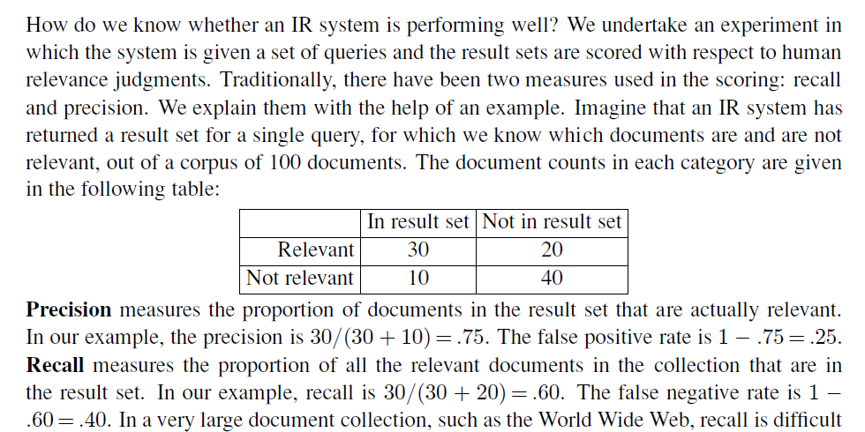

Slide 24
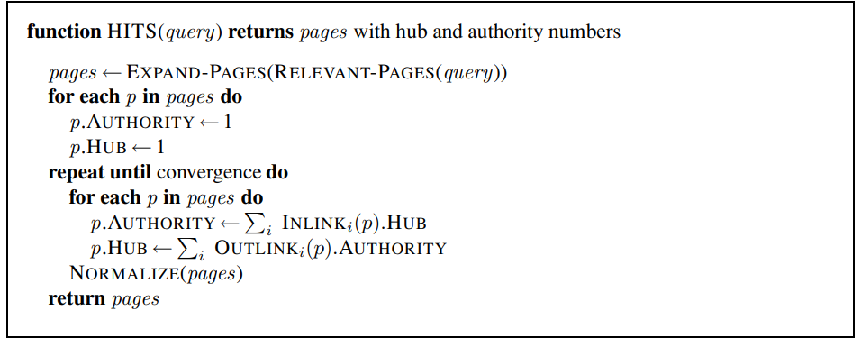
The PageRank algorithm PageRank (PR) is an algorithm used by Google Search to rank websites in their search engine results
PageRank was one of the two original ideas that set Google’s search apart from other Web search engines when it was introduced in 1997. [See Russell & Norvig, Section 22.3. Information Retrieval]

Slide 25
The PageRank algorithm
Figure 1 The HITS algorithm for computing hubs and authorities with respect to a query. RELEVANT-PAGES fetches the pages that match the query, and EXPAND-PAGES adds in every page that links to or is linked from one of the relevant pages. NORMALIZE divides each page’s score by the sum of the squares of all pages’ scores (separately for both the authority and hubs scores).

Slide 26
Working principle of PageRank
Therefore, the PageRank algorithm is designed to weight links from high-quality sites more heavily. What is a high quality site? One that is linked to by other high-quality sites. The definition is recursive

Slide 27

The PageRank algorithm
The PageRank for a page p is defined as:
where PR(p) is the PageRank of page p, N is the total number of pages in the corpus, ini are the pages that link in to p, and C(ini) is the count of the total number of out-links on page ini.
PageRank can be computed by an iterative procedure: start with all pages having PR(p)=1, and iterate the algorithm, updating ranks until they converge.

Slide 28
Information extraction
Information extraction is a process where relevant knowledge is gathered from a text by scanning it to identify specific types of objects (e.g., names, dates, or places) and the relationships between these objects (e.g., a person's association with a company or event). It focuses on extracting structured data from unstructured or semi-structured sources, such as documents or web pages.
In short, IE automates the task of finding meaningful information within large volumes of text.

Slide 29
Information extraction
Information extraction is the process of acquiring knowledge by skimming a text and looking for occurrences of a particular class of object and for relationships among objects.
A typical task is to extract instances of addresses from Web pages, with database fields for street, city, state, and zip code; or instances of storms from weather reports, with fields for temperature, wind speed, and precipitation.
In a limited domain, this can be done with high accuracy. As the domain gets more general, more complex linguistic models and more complex learning techniques are necessary.

Slide 30
Conditional random fields for information extraction
One issue with HMM (hidden Markov model) for the information extraction task is that they model a lot of probabilities that we don’t really need.
An HMM is a generative model; it models the full joint probability of observations and hidden states, and thus can be used to generate samples.
That is, we can use the HMM model not only to parse a text and recover the speaker and date, but also to generate a random instance of a text containing a speaker and a date.

Slide 31
Conditional random fields for information extraction
All we need in order to understand a text is a discriminative model, one that models the conditional probability of the hidden attributes given the observations (the text).
Given a text e1:N , the conditional model finds the hidden state sequence X1:N that maximizes P(X1:N | e1:N ).

Slide 32
Conditional random fields for information extraction
Modeling this directly gives us some freedom. We don’t need the independence assumptions of the Markov model—we can have an xt that is dependent on x1.
A framework for this type of model is the conditional random field, or CRF, which models a conditional probability distribution of a set of target variables given a set of observed variables.
Like Bayesian networks, CRFs can represent many different structures of dependencies among the variables.

Slide 33
Conditional random fields for information extraction
One common structure is the linear-chain conditional random field for representing Markov dependencies among variables in a temporal sequence.
Thus, HMMs are the temporal version of naive Bayes models, and linear-chain CRFs are the temporal version of logistic regression, where the predicted target is an entire state sequence rather than a single binary variable.

Slide 34

Conditional random fields for information extraction
Let e1:N be the observations (e.g., words in a document), and x1:N be the sequence of hidden states (e.g., the prefix, target, and postfix states).
A linear-chain conditional random field defines a conditional probability distribution:

Slide 35

Conditional random fields for information extraction
where α is a normalization factor (to make sure the probabilities sum to 1), and F is a feature function defined as the weighted sum of a collection of k component feature functions:
The λk parameter values are learned with a MAP (maximum a posteriori) estimation procedure that maximizes the conditional likelihood of the training data. The feature functions are the key components of a CRF.
The function fk has access to a pair of adjacent states, xi−1 and xi, but also the entire observation (word) sequence e, and the current position in the temporal sequence, i.

